Slide 1
Learning Representation for Matching Fingerprint Variants
Presented by
Anush Sankaran
TCS Research Scholar
Thesis Committee
Prof. Nasir Memon, NYU, USA
Prof. Davide Maltoni, UNIBO, Italy
Prof. Francisco Herrera, UGR, Spain
PhD Advisors
Dr. Mayank Vatsa
Dr. Richa Singh

Slide 2
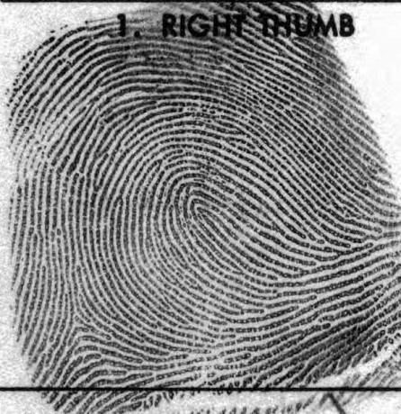
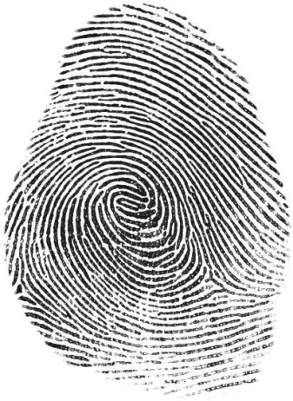
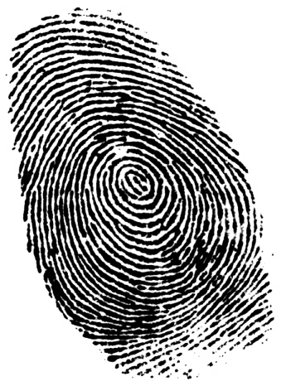
What is Fingerprint ?
The pattern of interleaved ridges and valleys on the tip of the finger
“Perhaps the most beautiful and characteristic of all superficial marks are the small furrows with the intervening ridges and their pores that are disposed in a singularly complex yet even order on the under surfaces on the hands and the feet.”
Francis Galton, Nature, June 28, 1888
Images from various sources in internet

Slide 3
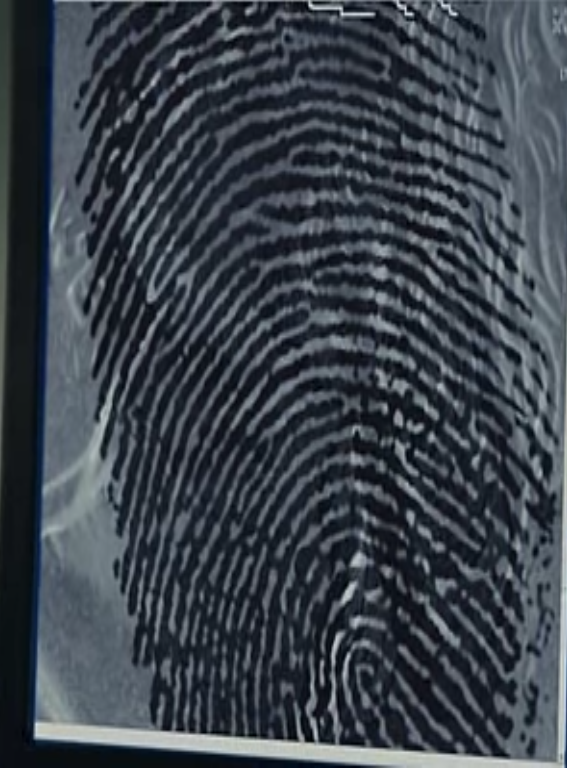
Automated Fingerprint Matching System 101
Finger Data

Slide 4
Automated Fingerprint Matching System 101
Finger Data
Quality Assessment
Not of enough quality. Hence, discard
Enough quality for further processing

Slide 5
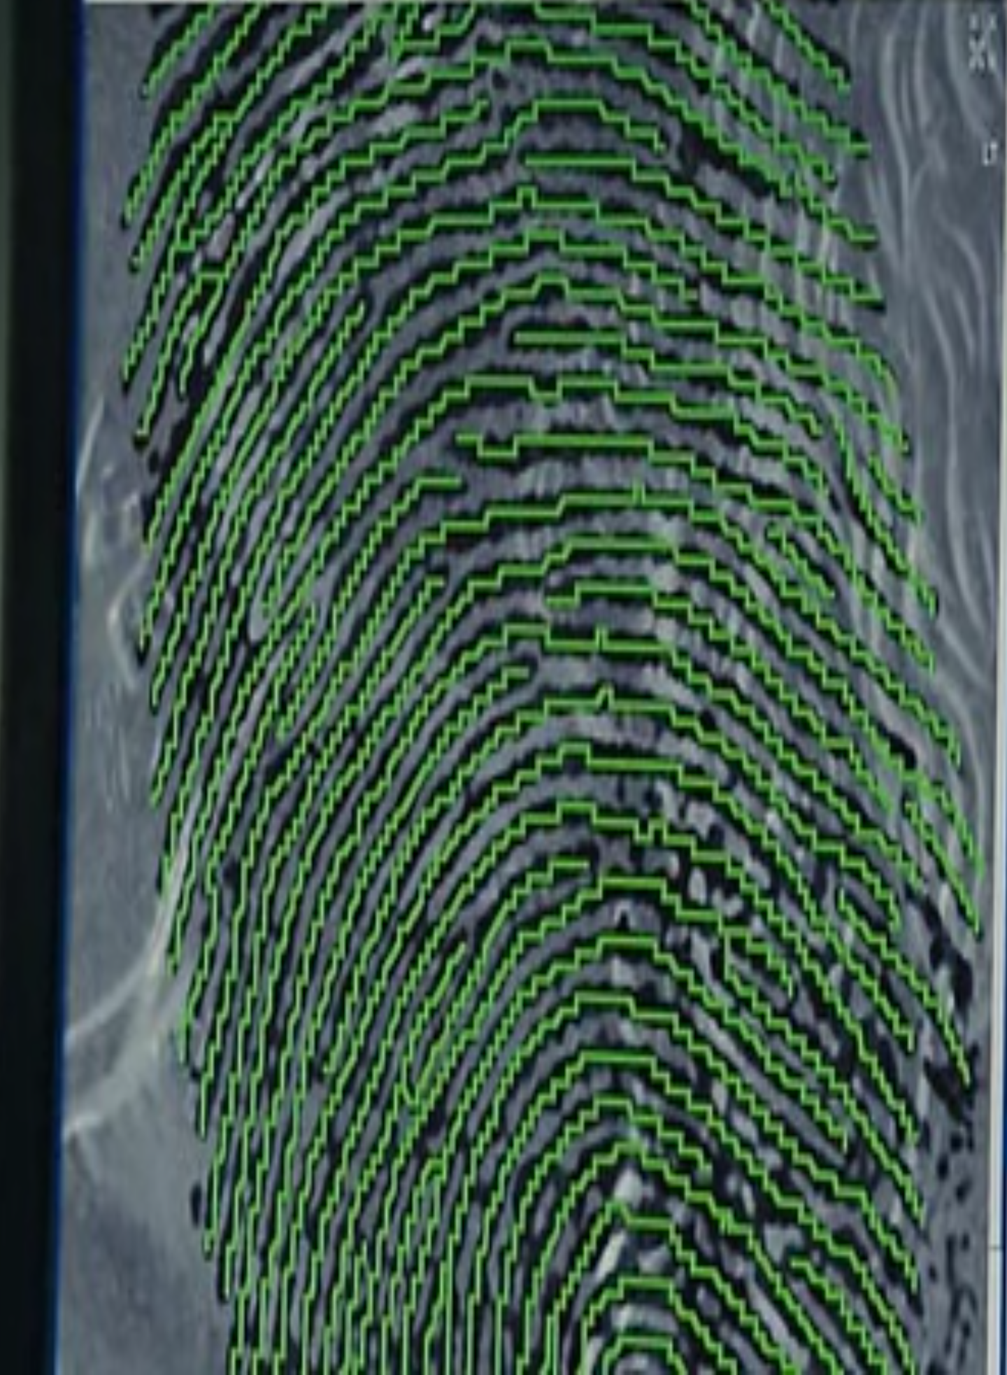
Automated Fingerprint Matching System 101
Finger Data
Quality Assessment
Preprocess
1. Segment
2. Remove Noise

Slide 6
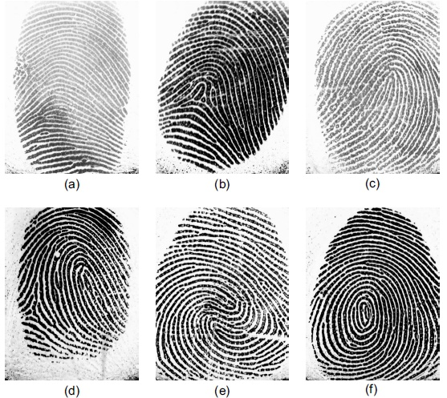
Automated Fingerprint Matching System 101
Finger Data
Quality Assessment
Feature
Extraction
Preprocess
Level 1:
Arch
Tented Arch
Left Loop
(d) Right Loop
(e) Twin Loop
(f) Whorl
Pattern Type
300 ppi image

Slide 7
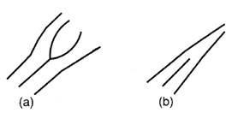
Automated Fingerprint Matching System 101
Finger Data
Quality Assessment
Feature
Extraction
Preprocess
Level 2:
Ridge bifurcation
(b) Ridge ending
Minutia points
500 ppi image

Slide 8
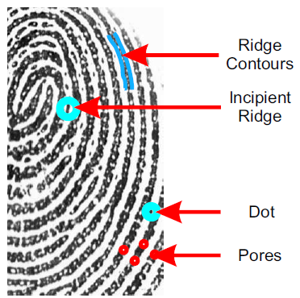
Automated Fingerprint Matching System 101
Finger Data
Quality Assessment
Feature
Extraction
Preprocess
Level 3:
Pores, Dots, incipients, ridge flow map
1000 ppi image

Slide 9
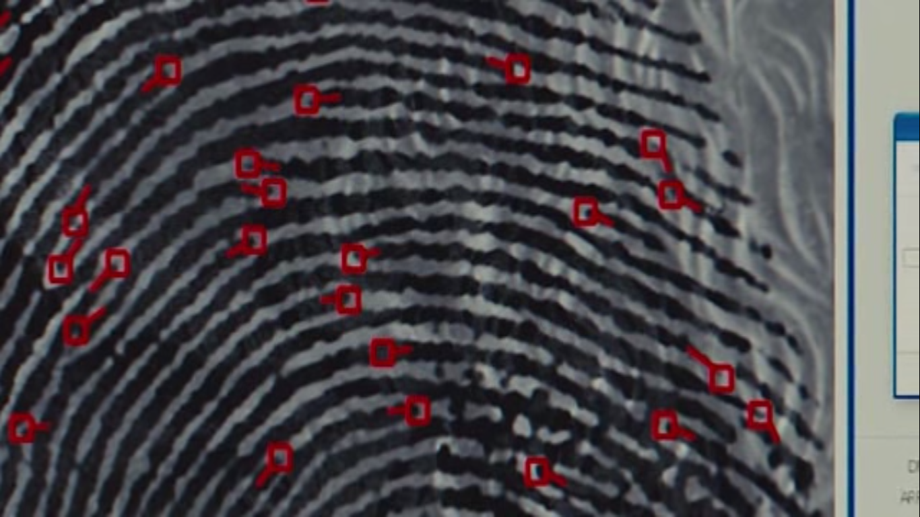
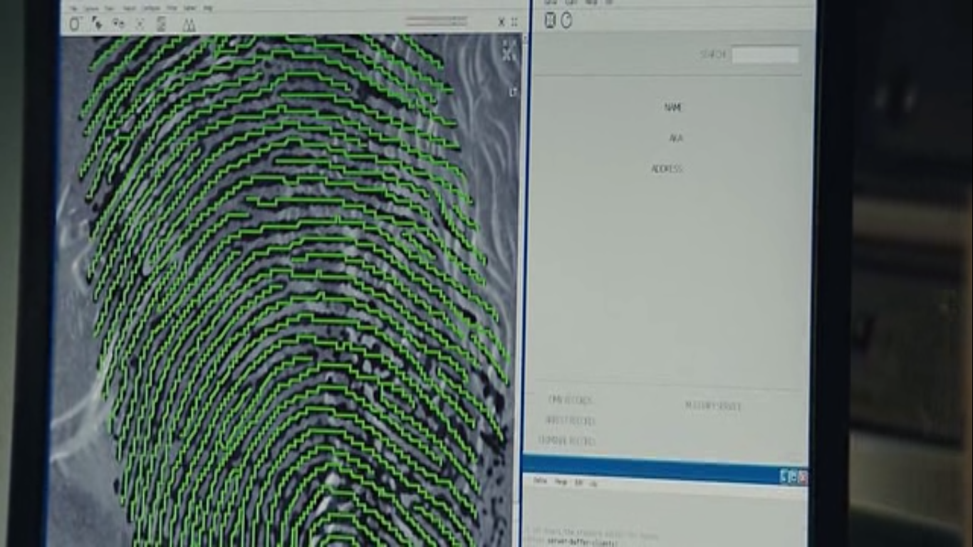
Automated Fingerprint Matching System 101
Finger Data
Quality Assessment
Feature
Extraction
Preprocess
<x₁, y₁, θ₁>
<x₂, y₂, θ₂>
…
<x_{n}, y_{n}, θ_{n}>
Minutiae
Features

Slide 10
Automated Fingerprint Matching System 101
Finger Data
Quality Assessment
Feature
Extraction
Feature
Comparison
Preprocess
<x₁, y₁, θ₁>
<x₂, y₂, θ₂>
…
<x_{n}, y_{n}, θ_{n}>
<x₁, y₁, θ₁>
<x₂, y₂, θ₂>
…
<x_{n}, y_{n}, θ_{n}>
<x₁, y₁, θ₁>
<x₂, y₂, θ₂>
…
<x_{n}, y_{n}, θ_{n}>
.
.
<x₁, y₁, θ₁>
<x₂, y₂, θ₂>
…
<x_{n}, y_{n}, θ_{n}>

Slide 11
Automated Fingerprint Matching System 101
Finger Data
Match Decision
Quality Assessment
Feature
Extraction
Feature
Comparison
Preprocess
<x₁, y₁, θ₁>
<x₂, y₂, θ₂>
…
<x_{n}, y_{n}, θ_{n}>
Match
<x₁, y₁, θ₁>
<x₂, y₂, θ₂>
…
<x_{n}, y_{n}, θ_{n}>

Slide 12
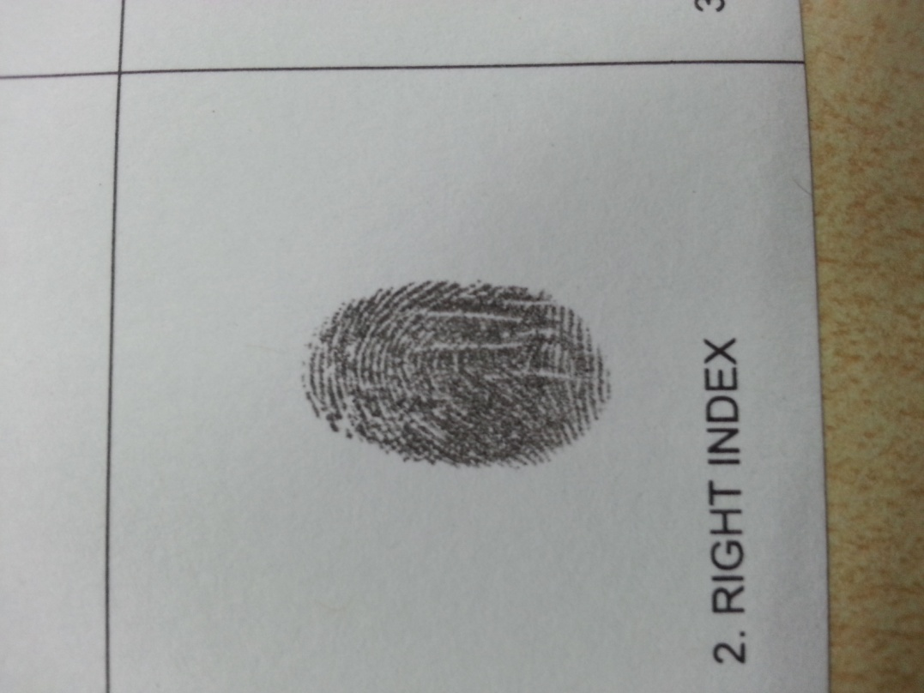
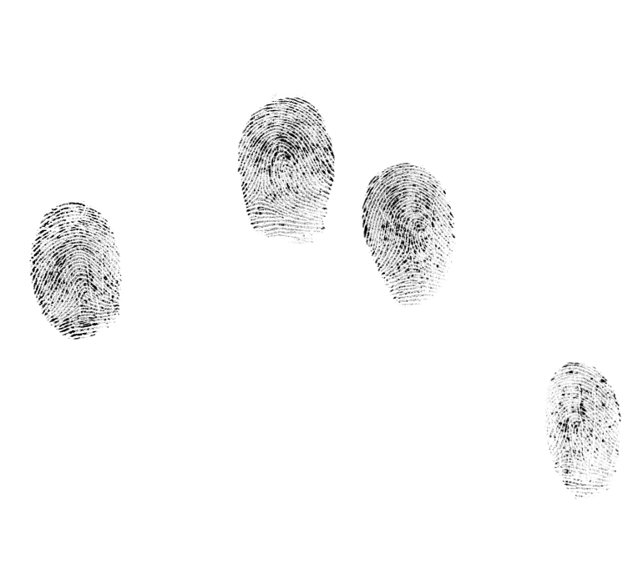
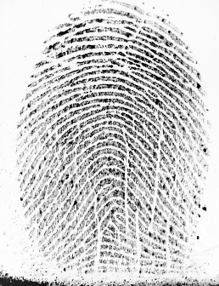
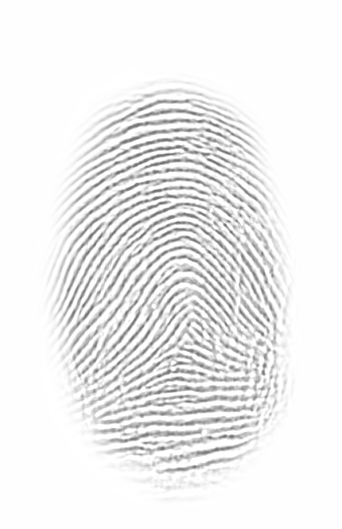
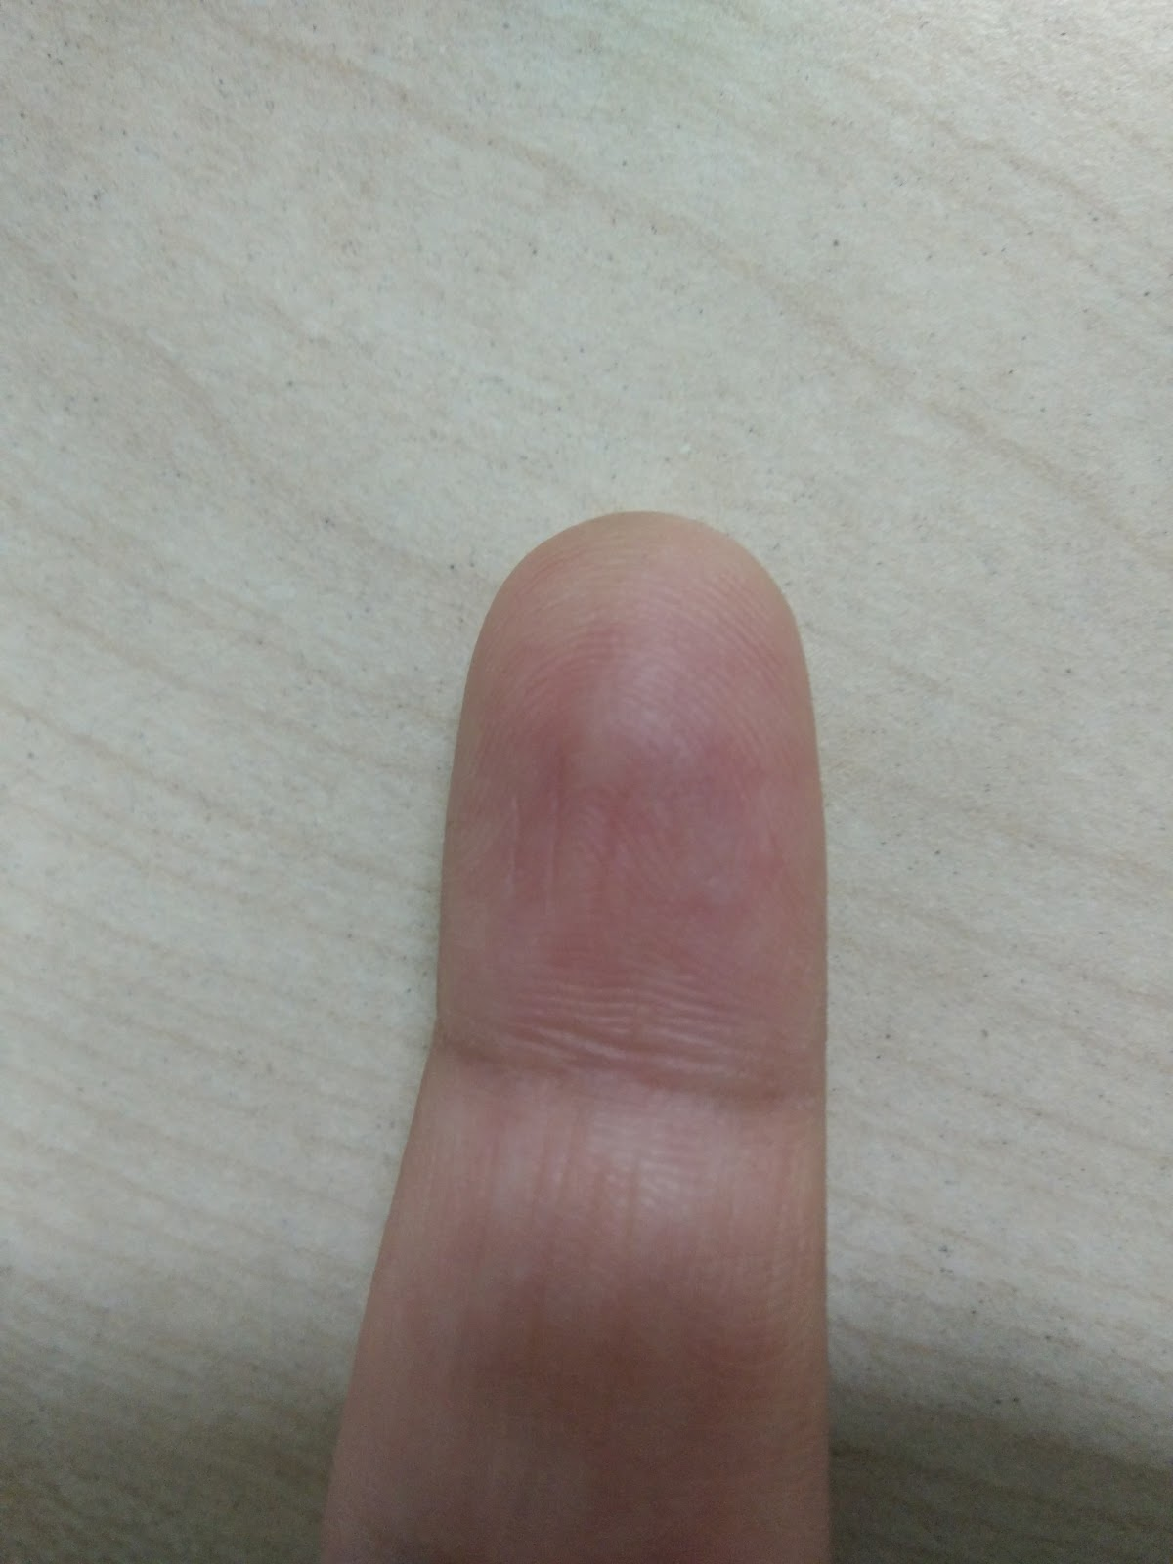
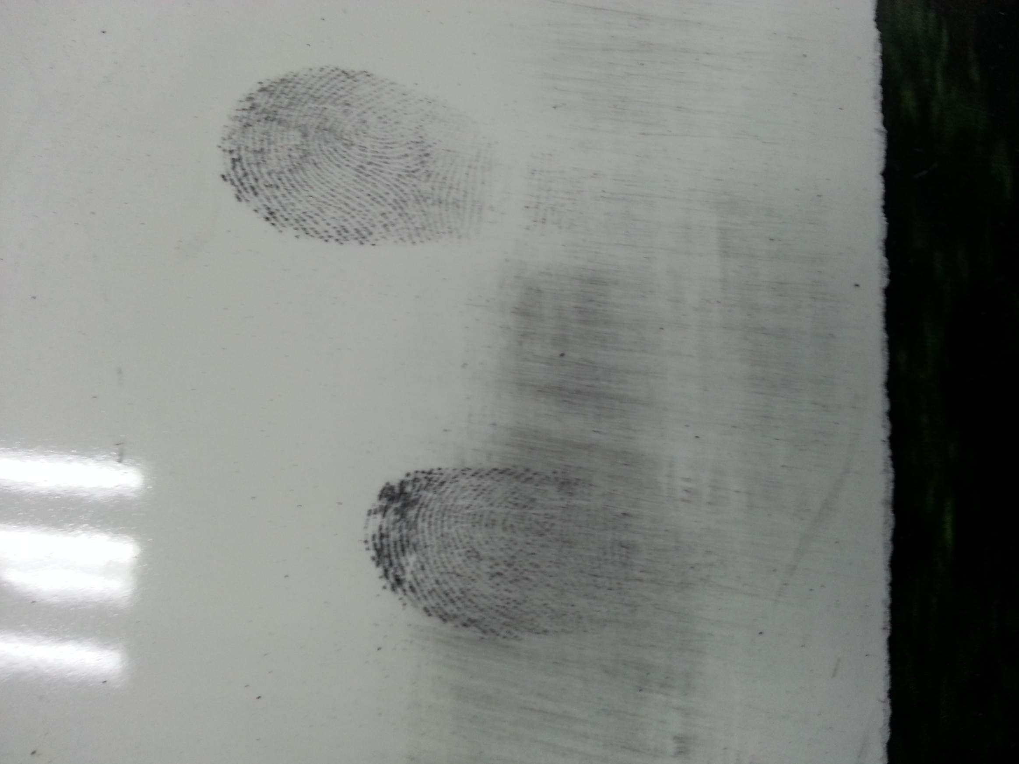
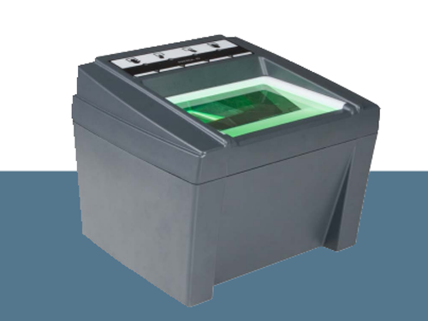
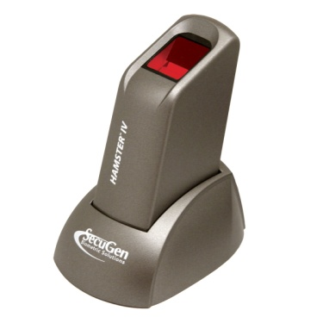
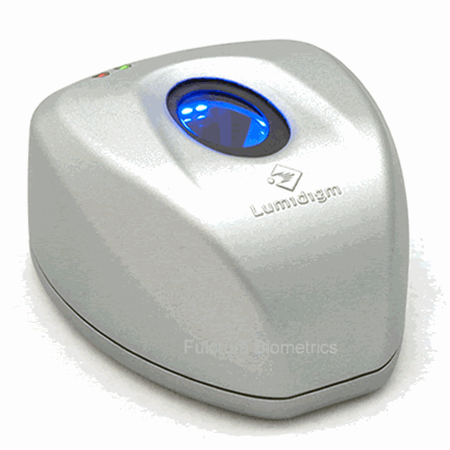
Fingerprint Variants: Based on Capture Type
Live-scan
Latent
Photo
Inked
Constrained
capture
Unconstrained
capture
Images from various sources in internet

Slide 13
Fingerprint Variants: Based on Capture Type
Live-scan
Inked
Research for comparing fingerprints captured in constrained environment is mature
NIST announced Fingerprint Vendor Technology Evaluation 2012 (FpVTE2012)
0.0009 FRR @ 10⁻³ FAR (against 10.6 Million database subjects)
Constrained
capture
Images from various sources in internet

Slide 14
Fingerprint Variants: Based on Capture Type
Latent
Photo
Aim of this thesis:
To develop
algorithms and solutions for
automated matching of fingerprints
captured in unconstrained environments
Unconstrained
capture
Images from various sources in internet

Slide 15
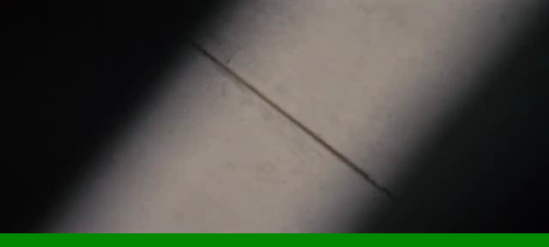
Common Understanding …
Common Mis-understanding …
It’s fiction !!!
Movie: Jack Reacher, 2012

Slide 16
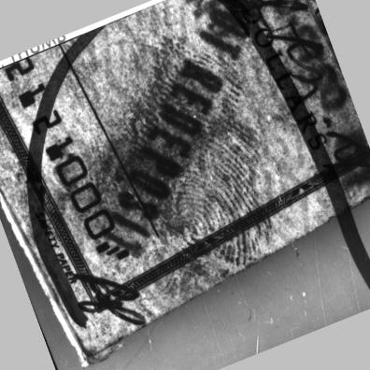
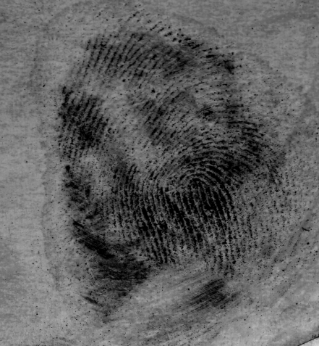
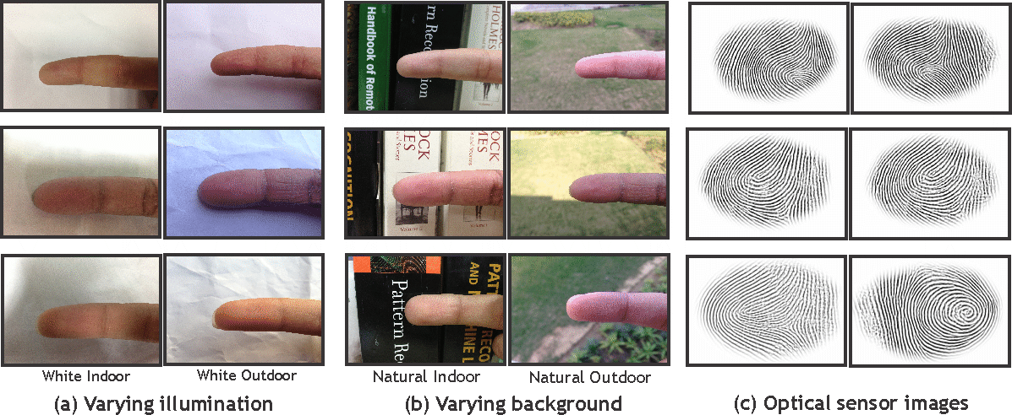
What are the Challenges?
Latent Fingerprints
Varying environment
Poor ridge quality
Currency note
Ceramic surface
Lack of feature representations
Fingerphoto Images
Lack of benchmark public databases
Indoor
Outdoor

Slide 17
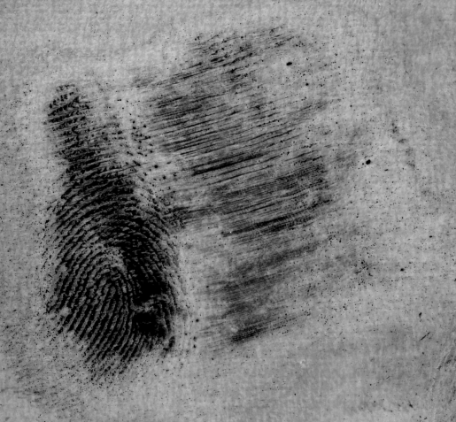
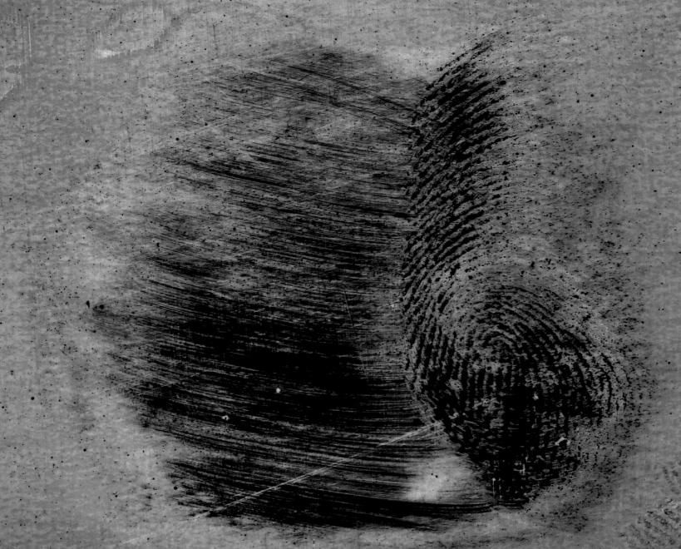
What are the Challenges?
Latent Fingerprints
Varying environment
Poor ridge quality
Smudges and partial ridge information
Lack of feature representations
Fingerphoto Images
Lack of benchmark public databases
Blur noise and shadows

Slide 18
What are the Challenges?
Latent Fingerprints
Varying environment
Poor ridge quality
Lack of feature representations
Fingerphoto Images
Lack of benchmark public databases
Minutiae extraction fails!

Slide 19
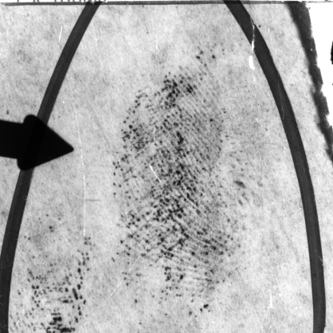
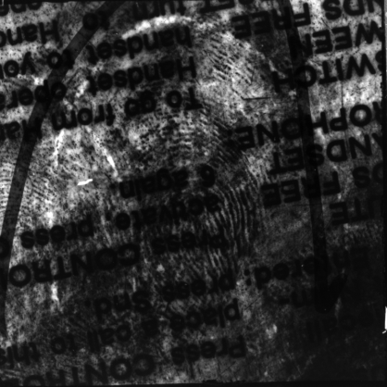
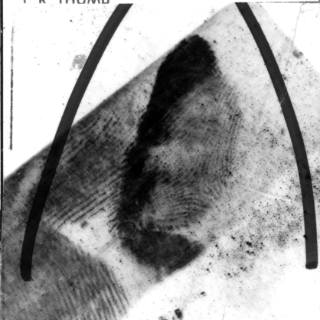
What are the Challenges?
Latent Fingerprints
NIST SD-27 : 258 images
Varying environment
Poor ridge quality
Lack of feature representations
Fingerphoto Images
No public dataset available
Lack of benchmark public datasets

Slide 20

Automated Fingerprint Matching System
Finger Data
Match Decision
Quality Assessment
Feature
Extraction
Feature
Comparison
Preprocess
Varying environment
Can these steps be automated
addressing these mentioned challenges?
Poor ridge quality
Lack of feature representations
Lack of benchmark public databases

Slide 21
Automated Fingerprint Matching System: Contributions
Finger Data
Match Decision
Quality Assessment
Feature
Extraction
Feature
Comparison
Preprocess
1
Create large dataset and make it public for promoting research and benchmarking
Latent fingerprint dataset
MOLF (Multi-sensor Optical and Latent Fingerprint) dataset: 4400 identities, 19200 fingerprints
IIITD SLF (Simultaneous Latent Fingerprint) dataset: 180 identities, 420 fingerprints
IIITD Latent to Latent Fingerprint dataset: 150 identities, 1241 fingerprints
Smartphone fingerphoto dataset
ISPFD-v1 (IIIT-D SmartPhone FingerPhoto Dataset version 1): 128 identities, 5100 fingerphotos
ISPFD-v2 (IIIT-D SmartPhone FingerPhoto Dataset version 2): 300 identities, 16000 fingerphotos, 3 resolutions

Slide 22
Automated Fingerprint Matching System: Contributions
Finger Data
Match Decision
Quality Assessment
Feature
Extraction
Feature
Comparison
Preprocess
2
Perform segmentation of the foreground ridge information and remove all the environmental noise during capture
Propose saliency as the key feature contributing for segmentation
Latent fingerprint matching:
Use gradient and text based features in addition to saliency
Fingerphoto matching:
Use skin color based features in addition to saliency

Slide 23
Automated Fingerprint Matching System: Contributions
Finger Data
Match Decision
Quality Assessment
Feature
Extraction
Feature
Comparison
Preprocess
3
Propose novel and deep features to uniquely represent finger ridge patterns during unconstrained capture
Latent fingerprint matching:
Propose group sparsity based autoencoder (GSAE)/ class sparsity based RBM (cssRBM) based feature representation for latent fingerprint
Fingerphoto matching:
Propose deep scattering networks based feature representation for fingerphoto images

Slide 24
Automated Latent Fingerprint Matching

Slide 25
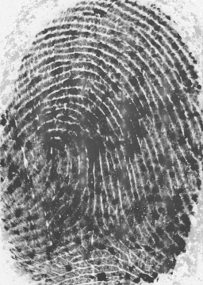
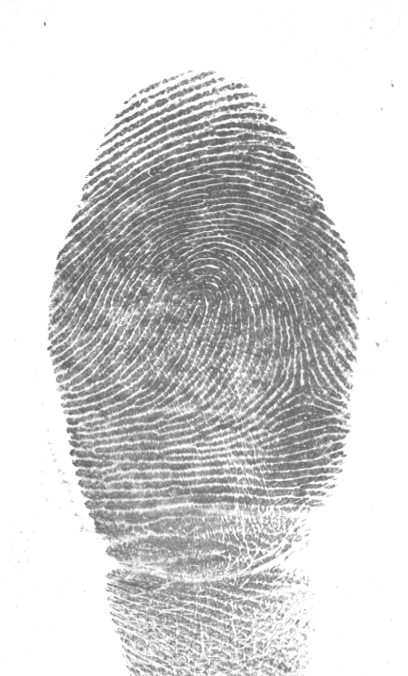
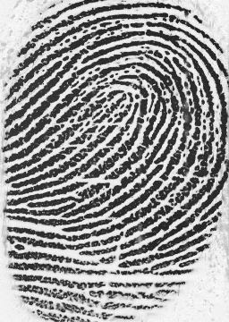
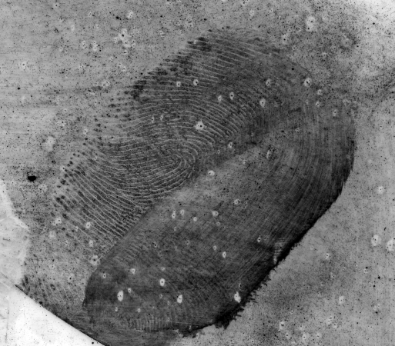
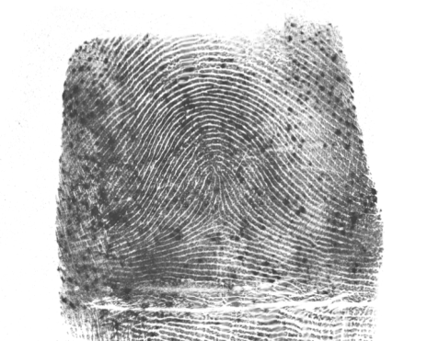
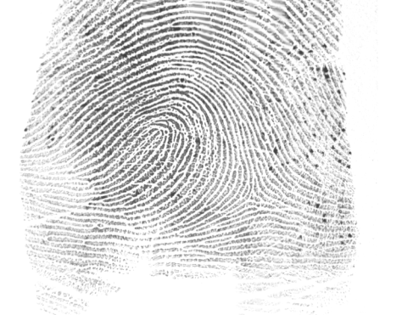
The Big Problem
(a)
(b)
(c)
Latent print
(d)
(e)
Exemplar prints

Slide 26
Automated Fingerprint Matching System: Latent Fingerprints
Finger Data
Match Decision
Quality Assessment
Feature
Extraction
Feature
Comparison
Preprocess
1

Slide 27
IIITD MOLF Dataset
Largest publicly available latent fingerprint dataset of 19200 fingerprints, along with
Live-scan fingerprint from 3 different sensors
Simultaneous latent fingerprint
Manually annotated minutiae points and ROI
#Labs using IIITD Latent datasets: 109
Subset | Fingerprint Type | #Images | Sensor
DB1 | Multi-spectral live-scan dap | 4000 | Lumidigm Venus IP65 Shell
DB2 | Live-scan dap | 4000 | Secugen Hamster IV
DB3 | Live-scan slap | 1200 | CrossMatch L-scan Patrol
DB3_A | Live-scan dap | 4000 | Cropped from DB3
DB4 | Latent | 4400 | Black powder dusting
DB5 | Simultaneous latent | 1600 | Black powder dusting
 | Total | 19200
(Thanks to Himanshu and Lakshay for assisting with the annotation task !)

Slide 28
IIITD MOLF Dataset: Sample Images
NFIQ Quality Distribution
Live-scan: Set I
Live-scan: Set II
Live-scan: Set III
Latent
1 – high quality
5 – low quality

Slide 29
IIITD MOLF Dataset: Baseline Results
(Rank-1 identification accuracy)
Live-scan fingerprint matching:
~ (96 - 98) %
(Rank-50 identification accuracy)
Latent fingerprint matching:
Manually annotated minutiae | Automatically extracted minutiae
~ (31 - 33) %
~ (6 - 7) %
Sankaran et al., “Multisensor Optical and Latent Fingerprint Database”, IEEE Access, vol.3, no., pp. 653 - 665, 2015. Impact Factor: 3.244

Slide 30
IIITD MOLF Dataset: Baseline Results
(Rank-1 identification accuracy)
Live-scan fingerprint matching:
~ (96 - 98) %
(Rank-50 identification accuracy)
Latent fingerprint matching:
Manually annotated minutiae | Automatically extracted minutiae
~ (31 - 33) %
~ (6 - 7) %
Sankaran et al., “Multisensor Optical and Latent Fingerprint Database”, IEEE Access, vol.3, no., pp. 653 - 665, 2015. Impact Factor: 3.244

Slide 31
Automated Fingerprint Matching System: Latent Fingerprints
Finger Data
Match Decision
Quality Assessment
Feature
Extraction
Feature
Comparison
Preprocess
2

Slide 32
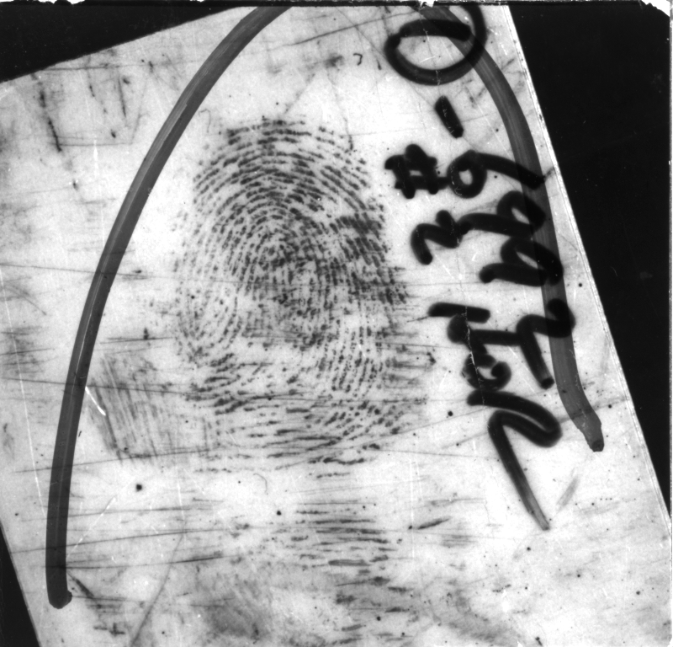
Segmentation: Problem Definition
Background
Foreground

Slide 33
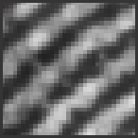
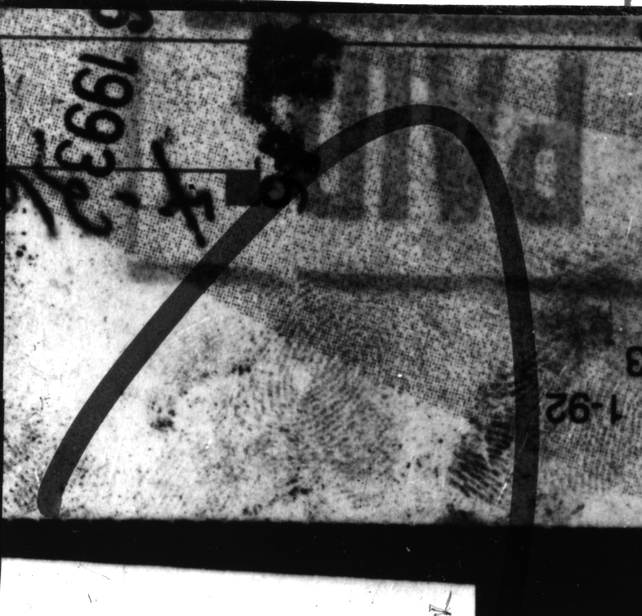
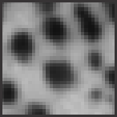
Latent Fingerprint Segmentation
Foreground
What features can classify a
foreground ridge patch
with a
background noise patch?
Background

Slide 34
Latent Fingerprint Segmentation
Research | Approach | Database | Results
Karimi and Kuo, 2008 | Ridge frequency estimation | 2 images from NIST-SD 27 | No quantitative results
Short et al., 2011 | Cross-correlation strength | NIST-SD 27 | Verification – EER of 33.8%
Zhang et al., 2012 | Adaptive Total Variational (TV-L1) model | 3 images from NIST-SD 27 | No quantitative results
Zhang et al., 2012 | Directional Total Variational (DTV) model | 3 images from NIST-SD 27 | No quantitative results
Choi et al., 2012 | Orientation + frequency tensor | NIST-SD 27 and WVU DB | Rank-1 matching accuracy for NIST SD-27 : 16.28% WVU DB : 35.19%

Slide 35
Basic Observations
Latent fingerprint is typically one of the most salient object in an image
Every local patch can be formulated as a binary classification – foreground/ background?

Slide 36
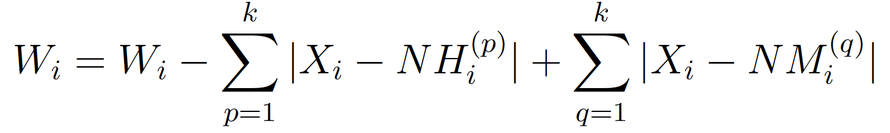
Proposed Approach
Saliency | Image intensity based | Gradient based | Ridge based | Quality based
𝑓1. Intensity 𝑓2. Orientation | 𝑓3. Difference of mean 𝑓4. Variance 𝑓5. Ridge cluster value | 𝑓6. Ridge orientation 𝑓7. Sum of squared gradient 𝑓8. Sum of norm of squared gradient 𝑓9. Variance of projected axis parallel to orientation 𝑓10. Variance of projected axis orthogonal to orientation 𝑓11-𝑓15. Mean of symmetry and texture patterns | 𝑓16. Average inter- ridge distance 𝑓17. Variance of peak heights in ridges 𝑓18. Ridge frequency 𝑓19. Angular bandwidth | 𝑓20. Ridge energy 𝑓21. Ridge energy after clustering 𝑓22. Ridge continuity map 𝑓23. Ridge clarity map
Modified RELIEF Algorithm:
Use ℓ1-norm to find the neighbours of 𝑋_{𝑖} instead of using Euclidean distance
Calculate the absolute difference between the points, instead of squared difference
Choose 𝑘-nearest neighbors of an instance 𝑋_{𝑖} instead of the single nearest neighbor.

Slide 37
Extracted Features

Slide 38
Inked Fingerprint (NIST-4)
Image intensity
Gradient-based
Ridge-based
Quality-based
Saliency-based
Intensity
Orientation
Difference of means
Variance
Ridge cluster
Ridge orientation
Squared gradient
Variance of gradient
Symmetry pattern
Ridge distance
Variance of peak ridge height
Ridge frequency
Angular bandwidth
Ridge energy
Ridge cluster energy
Ridge continuity
Ridge clarity
~
✓
~
✗
✓
✓
Best performing features
✗
Worst performing features
~
Neutral performing features

Slide 39
Latent Fingerprint (NIST SD-27)
Image intensity
Gradient-based
Ridge-based
Quality-based
Saliency-based
Intensity
Orientation
Difference of means
Variance
Ridge cluster
Ridge orientation
Squared gradient
Variance of gradient
Symmetry pattern
Ridge distance
Variance of peak ridge height
Ridge frequency
Angular bandwidth
Ridge energy
Ridge cluster energy
Ridge continuity
Ridge clarity
✗
✗
✓
~
✓
✓
Best performing features
✗
Worst performing features
~
Neutral performing features

Slide 40
Latent Fingerprint (IIITD)
Image intensity
Gradient-based
Ridge-based
Quality-based
Saliency-based
Intensity
Orientation
Difference of means
Variance
Ridge cluster
Ridge orientation
Squared gradient
Variance of gradient
Symmetry pattern
Ridge distance
Variance of peak ridge height
Ridge frequency
Angular bandwidth
Ridge energy
Ridge cluster energy
Ridge continuity
Ridge clarity
✓
~
✗
~
✓
✓
Best performing features
✗
Worst performing features
~
Neutral performing features

Slide 41
Proposed Approach: Step-wise
Input Latent Print
Classified Patches
Largest Connected Component

Slide 42
Evaluation Metrics
Segmentation Accuracy (SA)
Foreground segmentation accuracy (FSA)
Background segmentation accuracy (BSA)
Matching Accuracy
Rank-50 identification accuracy
Number of correctly classified patches
SA =
Total number of patches
Number of correctly classified foreground patches
FSA =
Total number of foreground patches
Number of correctly classified background patches
BSA =
Total number of background patches

Slide 43
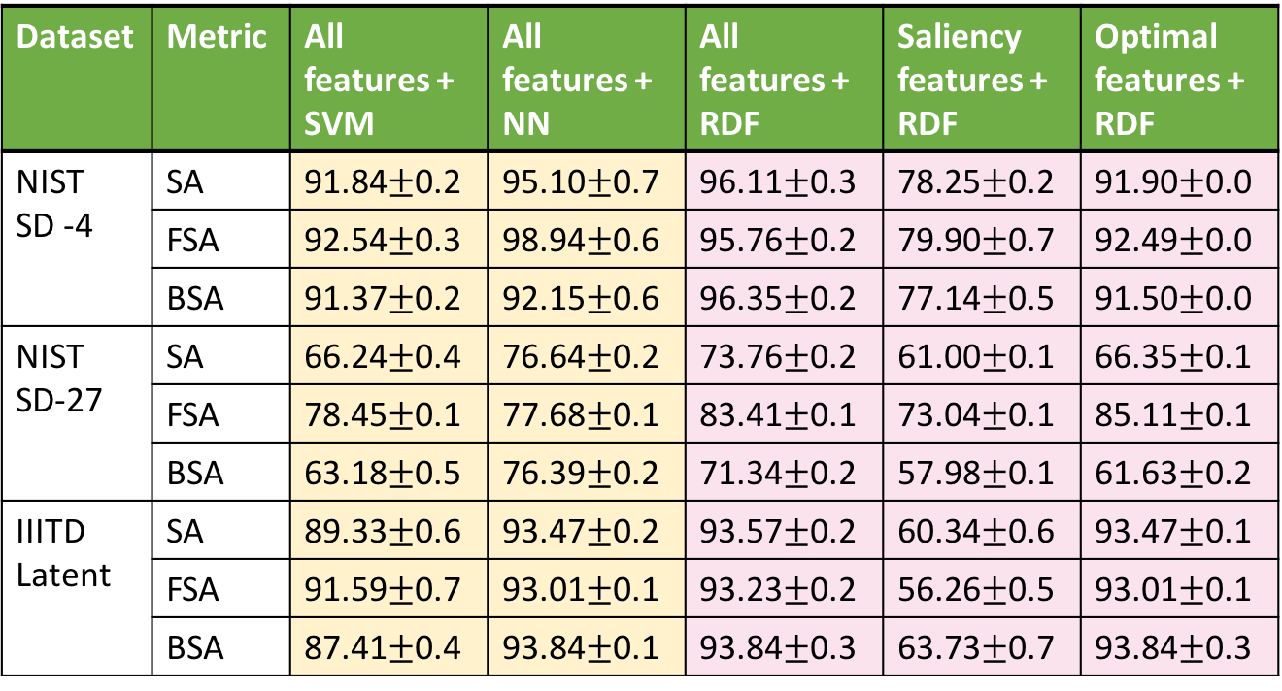
Segmentation Accuracy
Dataset | Metric | All features + SVM | All features + NN | All features + RDF | Saliency features + RDF | Optimal features + RDF
NIST SD -4 | SA | 91.84$±$0.2 | 95.10$±$0.7 | 96.11$±$0.3 | 78.25$±$0.2 | 91.90$±$0.0
 | FSA | 92.54$±$0.3 | 98.94$±$0.6 | 95.76$±$0.2 | 79.90$±$0.7 | 92.49$±$0.0
 | BSA | 91.37$±$0.2 | 92.15$±$0.6 | 96.35$±$0.2 | 77.14$±$0.5 | 91.50$±$0.0
NIST SD-27 | SA | 66.24$±$0.4 | 76.64$±$0.2 | 73.76$±$0.2 | 61.00$±$0.1 | 66.35$±$0.1
 | FSA | 78.45$±$0.1 | 77.68$±$0.1 | 83.41$±$0.1 | 73.04$±$0.1 | 85.11$±$0.1
 | BSA | 63.18$±$0.5 | 76.39$±$0.2 | 71.34$±$0.2 | 57.98$±$0.1 | 61.63$±$0.2
IIITD Latent | SA | 89.33$±$0.6 | 93.47$±$0.2 | 93.57$±$0.2 | 60.34$±$0.6 | 93.47$±$0.1
 | FSA | 91.59$±$0.7 | 93.01$±$0.1 | 93.23$±$0.2 | 56.26$±$0.5 | 93.01$±$0.1
 | BSA | 87.41$±$0.4 | 93.84$±$0.1 | 93.84$±$0.3 | 63.73$±$0.7 | 93.84$±$0.3

Slide 44
Matching Accuracy
NIST SD-27: Latent Fingerprints

Slide 45
Matching Accuracy
IIITD Dataset: Latent Fingerprints
Sankaran et al., “Adaptive latent fingerprint segmentation using feature selection and random decision forest classification”, Information Fusion, Elsevier, vol. 34, pp. 1-15, 2017. Impact Factor: 5.667

Slide 46
Automated Fingerprint Matching System: Latent Fingerprints
Finger Data
Match Decision
Quality Assessment
Feature
Extraction
Feature
Comparison
Preprocess
3

Slide 47
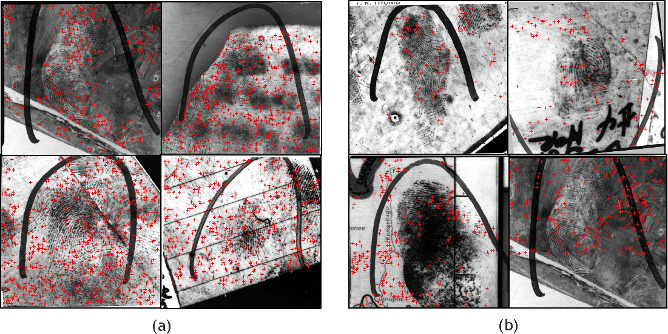
Existing Minutiae Extraction System
VeriFinger 6.0 SDK
State-of-art Commercial system
NBIS
Open source package from NIST

Slide 48
Minutiae and Non-minutiae Patch
Non-minutiae patch
Minutiae patch
Describe the local patches ?

Slide 49
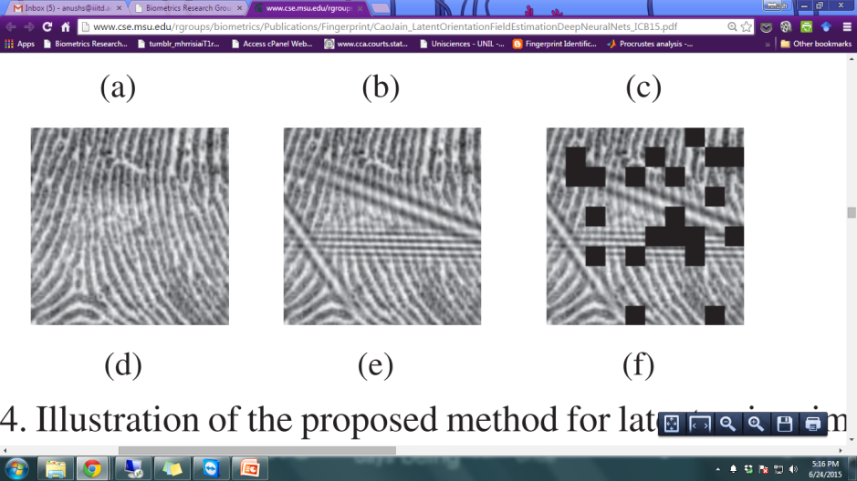

Denoising Sparse Autoencoder
Input
layer
Noisy
input
Calculate error
w.r.t
original input
.
.
.
.
.
.
.
.
.
.
.
.
Sparse
representation

Slide 50
Denoising Sparse Autoencoder: Drawback
Input
layer
Noisy
input
Extracted features are good for
Reconstruction
and not
Classification !!!
.
.
.
.
.
.
.
.
.
.
.
.
Sparse
representation

Slide 51
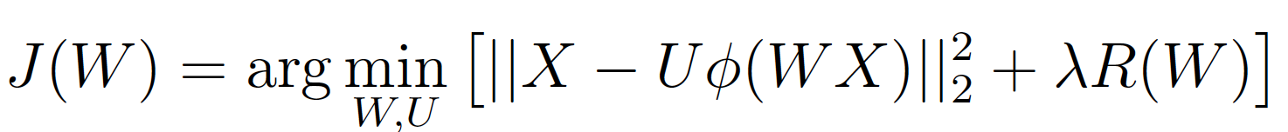
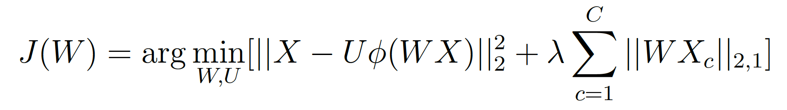
Solution Using Supervised ℓ-2,1 norm
Autoencoder: Loss function
Input
image
Reconstructed image
Reconstruction loss
Regularization
Group Sparse Autoencoder: Loss function with supervised ℓ-2,1 norm
Reconstruction loss
Supervised
loss
Sankaran et al., “Group Sparse Autoencoder”, Image and Vision Computing, Elsevier, vol. 60, pp. 64-74, 2017. Impact Factor: 2.671

Slide 52
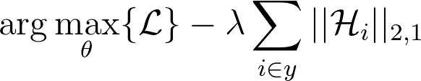
Class Sparse Signature based RBM (cssRBM)
Restricted Boltzmann Machines (RBM) is an energy based deep learning model for extracting complex features
ℓ-2,1 regularization is added to the loss function to introduce within-class sparsity
Extended to Deep Boltzmann Machines (DBM) as cssDBM
Extended to Deep Belief Networks (DBN) as cssDBN
Sankaran et al., “Class Sparsity Signature based Restricted Boltzmann Machines”, Pattern Recognition, Elsevier, vol. 61, pp. 674-685, 2017. Impact Factor: 4.582

Slide 53
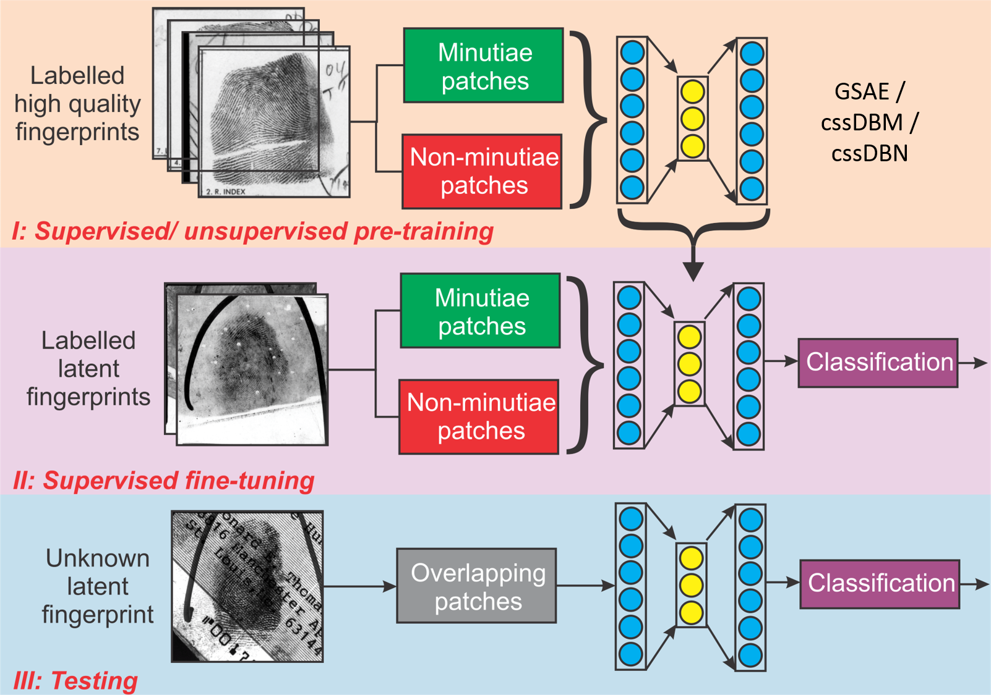
Latent Fingerprint Minutiae Extraction

Slide 54
Extracted Minutiae Patches
NIST SD-27: Sample Images
Green patch : Extracted patch
Red dots: Ground truth minutiae

Slide 55
Experimental Data
Heterogeneous high quality fingerprint database collection
Database | Property | #Images | #Minutiae
NIST SD-14 v2 | Card print database | 54,000 | 8,188,221
CASIA Fingerprint v5 | Optical | 20,000 | 515,641
MCYT | Optical, capacitive | 24,000 | 571,713
FingerPass | Optical, capacitive | 35,560 | 812,643
 | Total | 132,560 | 10,088,218
Latent fingerprint database
Dataset | #Images | #TrainPatches | #TestPatches
NIST SD-27 | 258 | 9757 | 65,274
 | Fold 1 | 5,503 | 65,274
 | Fold 2 | 5,439 | 65,274
 | Fold 3 | 5,441 | 65,274
MOLF | 4,400 |  | 422,400

Slide 56
Evaluation Metrics
Correct classification accuracy (CCA)
Minutiae detection accuracy (MDA)
Non-minutiae detection accuracy (NMDA)
Matching Accuracy
Rank-50 identification accuracy
CCA =
Number of correctly classified patches
Total number of patches
Number of correctly classified minutiae patches
MDA =
Total number of minutiae patches
Number of correctly classified non-minutiae patches
NMDA =
Total number of non-minutiae patches

Slide 57
Minutiae Extraction Accuracy
NIST SD-27: Latent Fingerprints
Algorithm | CCA (%) | MDA (%) | NMDA (%)
VeriFinger | 90.33 | 20.41 | 96.80
KLD | 99.31 | 91.90 | 100
GSAE | 99.53 | 94.48 | 100
KLD + GSAE | 99.61 | 95.37 | 100
cssDBN | 99.67 | 96.16 | 100
cssDBM | 99.68 | 96.21 | 100

Slide 58
Minutiae Extraction Accuracy
IIITD Dataset: Latent Fingerprints
Algorithm | CCA (%) | MDA (%) | NMDA (%)
VeriFinger | 78.52 | 21.33 | 92.92
KLD | 59.25 | 84.17 | 52.97
GSAE | 90.14 | 90.44 | 90.07
KLD + GSAE | 90.74 | 90.63 | 90.37
cssDBN | 92.16 | 92.37 | 92.11
cssDBM | 92.19 | 92.45 | 92.12

Slide 59
Matching Accuracy
Black box commercial system

Slide 60
Summary
Finger Data
Match Decision
Quality Assessment
Feature
Extraction
Feature
Comparison
Preprocess
1. MOLF Dataset
2. 19,200 images
3. Baseline: ~(6-9)% rank-50 identification accuracy
1. Segmentation based on Saliency + dataset dependent features
2. Binary classification problem
1. GSAE / cssDBM/ cssDBN
2. Binary classification problem
Rank-50 identification accuracy:
1. GSAE: 69.83%
2. cssDBN: 71.95%
3. cssDBM: 71.97%

Slide 61
Matching Fingerphoto Images

Slide 62
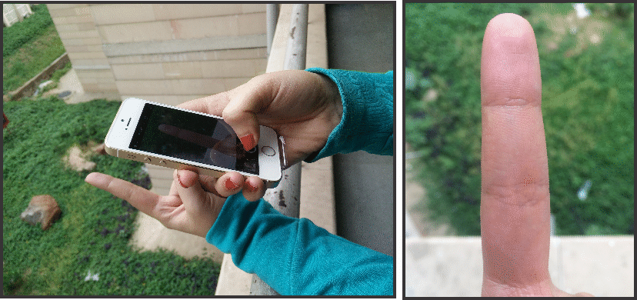
Fingerphoto An Alternative Biometric For Smartphones

Slide 63
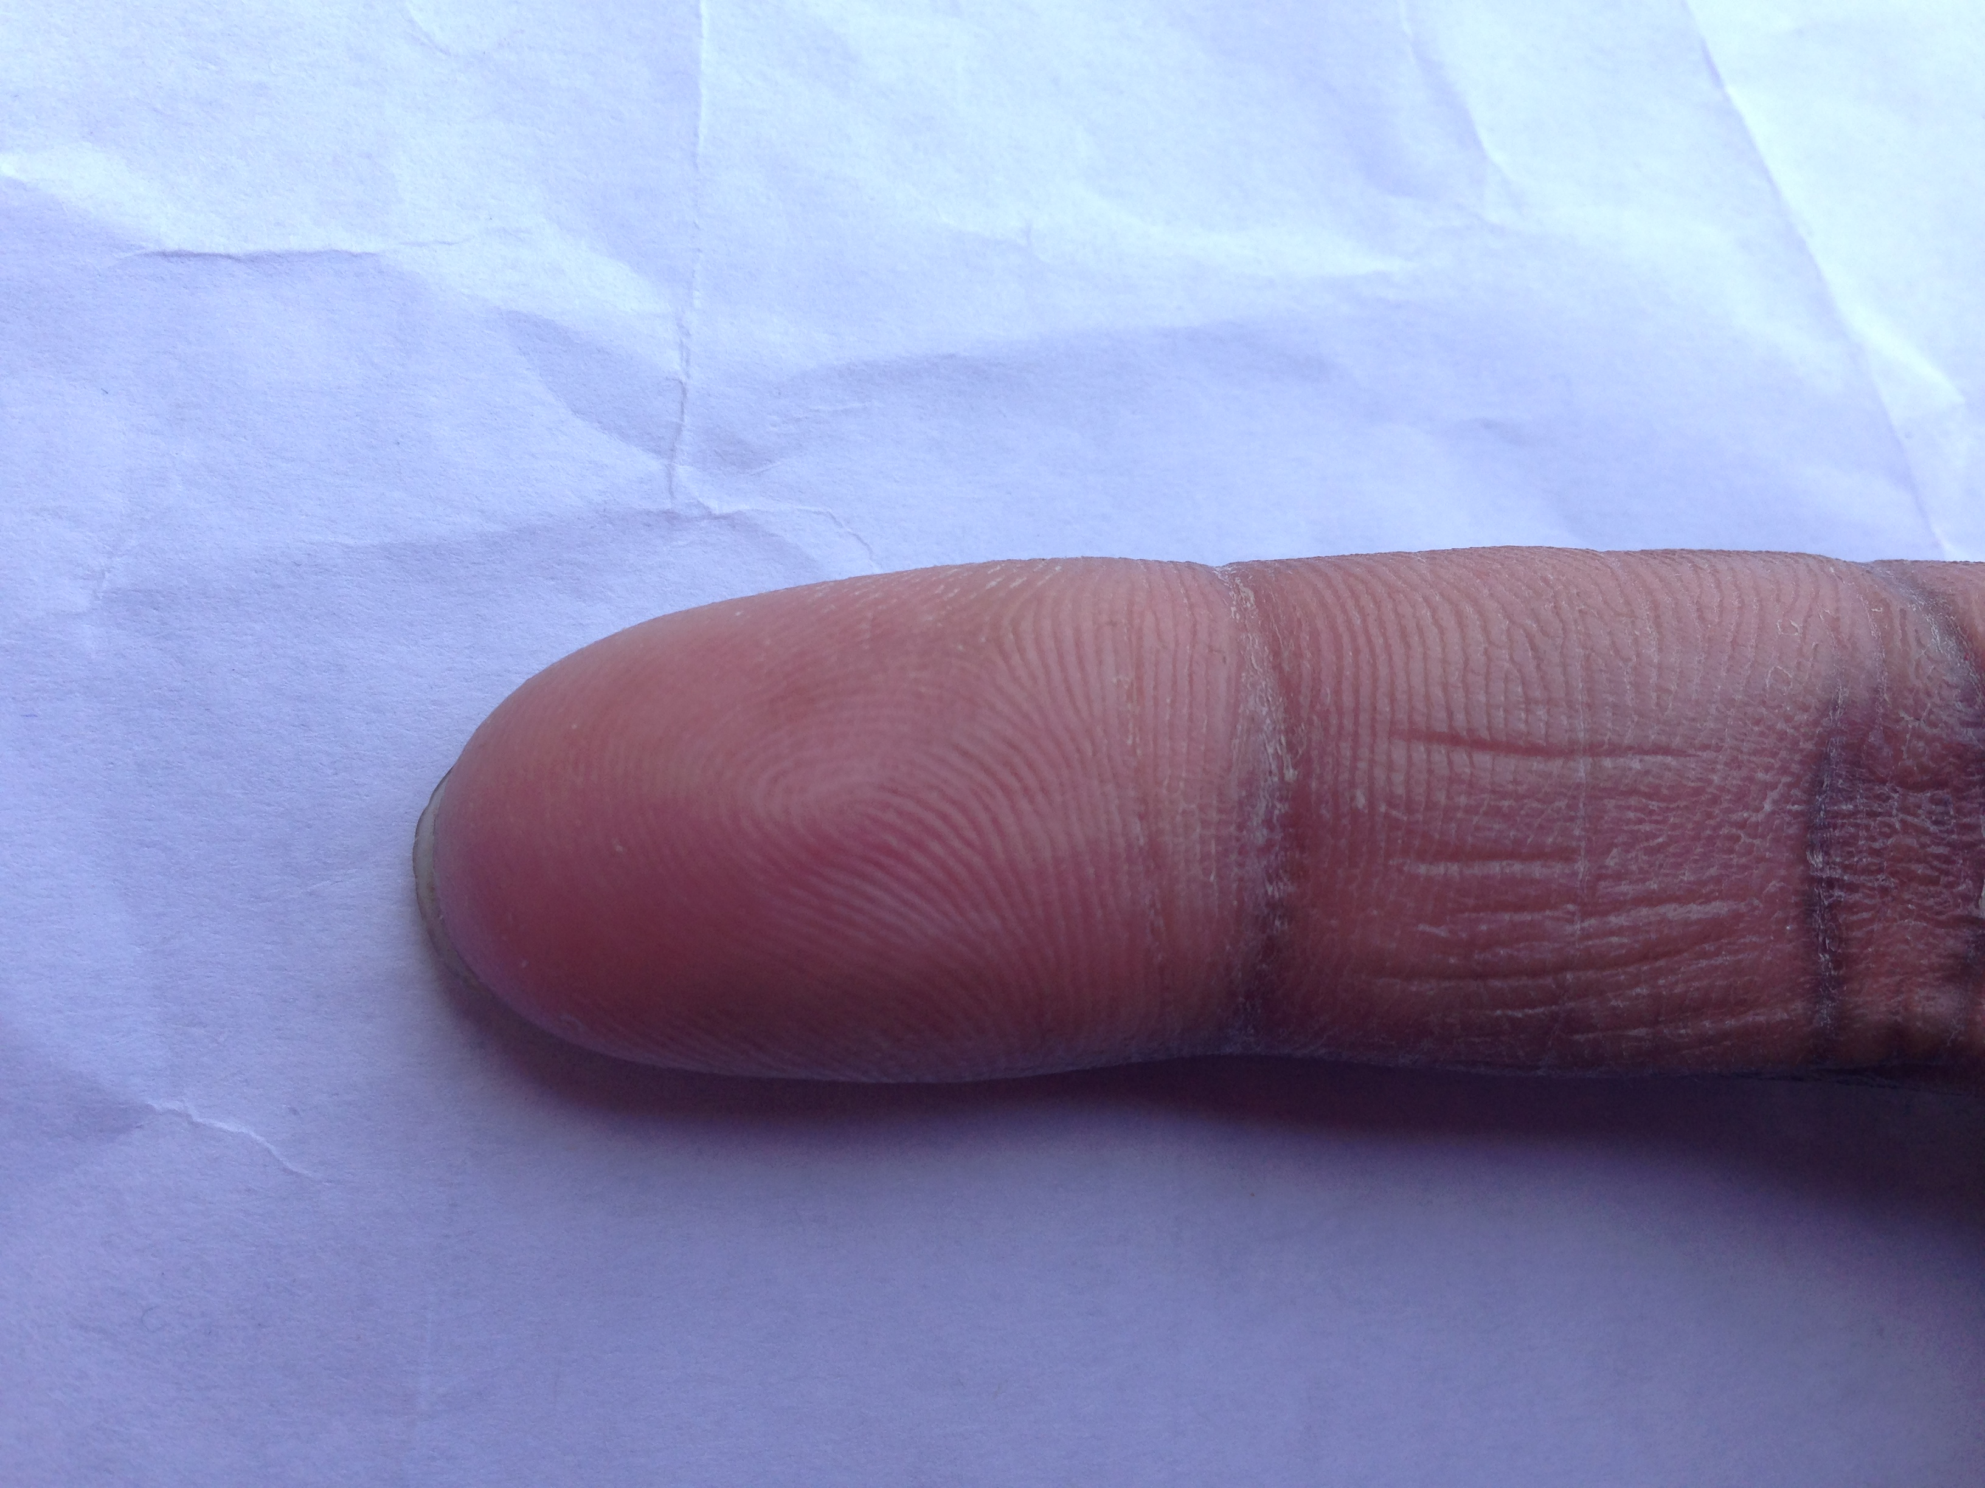
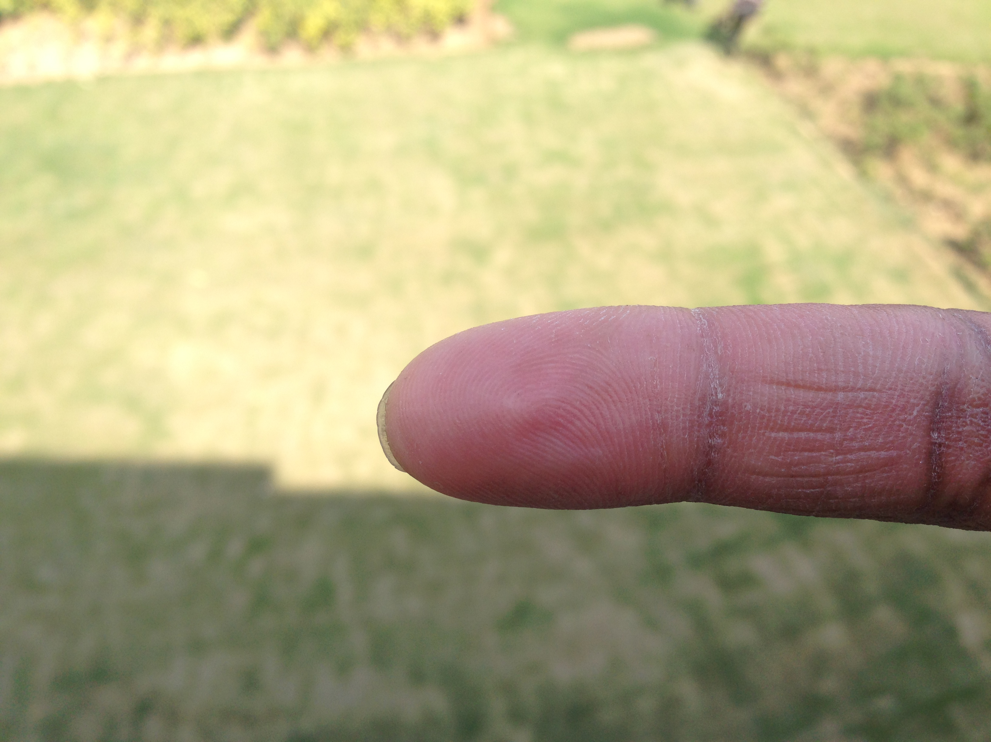
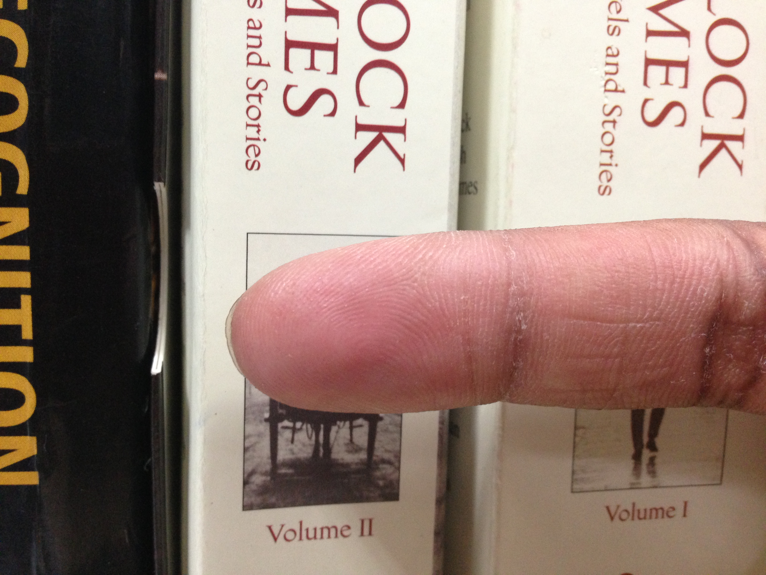
Problem Statement
Templates
Test Image
Match
or
Not match ?

Slide 64
Literature Study
Research Paper | Problems | Database | Remarks
Lee et al., 2005 | Segmentation Orientation | 2 subset of 400 & 800 images | DB not made public
Lee et al., 2008 | Yaw, roll, pose | Samsung DB-I, II, III, IV | Controlled illumination DB not made public
Stein et al., 2012 | Segmentation Pitch Quality | 41 subjects, 2 mobiles | Real time matching DB not made public
Li et al., 2012 | Illumination Resolution | 2100 images, 3 mobiles | Manual segmentation DB not made public
Li et al., 2013 | Quality | 2100 images, 3 mobiles | Manual segmentation DB not made public
Stein et al., 2013 | Enhancement Spoofing | 990 images, 66 videos | Controlled background Controlled illumination DB not made public

Slide 65
IIITD SmartPhone Fingerphoto Database v2
16,800 images from 300 fingers
Address three challenges:
Background variation
White background
Natural background
Illumination variation
Indoor illumination
Outdoor illumination
Resolution variation
5 MP
8 MP
13 MP
16 MP
Captured using two different phones
OnePlus One (OPO)
MicroMax Canvas Knight

Slide 66
IIITD SmartPhone Fingerphoto Database v2
Set | Challenge | Variations |  |  | #Classes | #Images
 |  | Illumination | Background | Resolution
Set I | White Indoor | Controlled | White | 13 MP | 300 | 2400
 | White Outdoor | Uncontrolled | White | 13 MP | 300 | 2400
Set II | Natural Indoor | Controlled | Natural | 13 MP | 300 | 2400
 | Natural Outdoor | Uncontrolled | Natural | 13 MP | 300 | 2400
Set III | Resolution | Controlled | White | 5 MP | 300 | 2400
 | Resolution | Controlled | White | 8MP | 300 | 2400
 | Resolution | Controlled | White | 16 MP | 300 | 2400
 |  |  |  |  | Total | 16800
(Thanks to Aakarsh and Apoorva for assisting in the database collection process!)

Slide 67
Proposed Approach

Slide 68
Saliency based Segmentation

Slide 69
Fingerphoto Enhancement
Median filter is applied to remove any speckle noise
Histogram equalization increases the contrast of ridge structures
Sharpening removes low frequency components

Slide 70

Deep ScatNet based Features
Anden J. and Mallat. S., Deep Scattering Spectrum, IEEE Transactions on Signal Processing, Vol. 62, No. 16, August 15, 2014

Slide 71
Deep ScatNet based Features

Slide 72


Fingerphoto Verification
ScatNet
features
PCA
ℓ-1
distance
Gallery
-
Difference
Probe
Random
Decision
Forest
ScatNet
features
PCA

Slide 73
Verification Performance
Metric: Equal Error Rate (EER)
Non-minutiae
based
algorithms
Minutiae
based
algorithms
ScatNet
based
algorithms
Exp | Challenge | #Classes | Comp Code | MCC | NBIS | Minaee Wang | ScatNet + ℓ-1 | ScatNet + NN | ScatNet + RDF
Exp I | White Indoor | White Outdoor | 16.50 | 19.07 | 50.00 | 23.34 | 16.95 | 3.27 | 3.00
 |  | Natural Indoor | 12.36 | 16.22 | 49.87 | 22.04 | 20.39 | 6.50 | 3.21
 |  | Natural Outdoor | 17.03 | 21.40 | 49.99 | 22.96 | 20.59 | 5.34 | 2.11
ExpII | Resolution (13 MP) | 5 MP | 10.35 | 14.32 | 50.00 | 13.65 | 15.72 | 7.53 | 5.23
 |  | 8 MP | 10.01 | 13.03 | 49.98 | 16.21 | 17.93 | 5.42 | 4.74
 |  | 16 MP | 48.48 | 10.84 | 50.00 | 21.38 | 17.07 | 3.73 | 2.98

Slide 74
Effect of Enhancement
Metric: Equal Error Rate (EER)

Slide 75
Effect of Enhancement
Metric: Equal Error Rate (EER)

Slide 76
Summary
Finger Data
Match Decision
Quality Assessment
Feature
Extraction
Feature
Comparison
Preprocess
1. ISPFD-v2 Dataset
2. 16,000 images
3. Three variations: Background, illumination, resolution
1. Segmentation based on Saliency + Skin color
2. Enhancement through sharpening
Deep Scattering Networks
RDF based verification
EER: (2-5)%
Existing algorithms: (13 - 23)% EER

Slide 77
Publications and Achievements

Slide 78
Journals & Book Chapters
A. Sankaran, A. Malhotra, M. Vatsa, and R. Singh, Fingerphoto Authentication using Deep Scattering Networks, IEEE Transaction on Information Forensics and Security (under review). Impact Factor: 4.332
A. Sankaran, A. Majumdar, M. Vatsa, and R. Singh, Group Sparse Autoencoder, Image and Vision Computing, Special Issue on Regularization Techniques for High-Dimensional Data Analysis, Elsevier, vol. 60, pp. 64-74, 2017. Impact Factor: 2.671
A. Sankaran, A. Jain, T. Vashisth, M. Vatsa, and R. Singh, Adaptive latent fingerprint segmentation using feature selection and random decision forest classification, Information Fusion, Elsevier, vol. 34, pp. 1-15, 2017. Impact Factor: 5.667
A. Sankaran, G. Goswami, M. Vatsa, R. Singh, and A. Majumdar, Class Sparsity Signature based Restricted Boltzmann Machines, Pattern Recognition, Special Issue on Deep Image Video, Elsevier, vol. 61, pp. 674-685, 2017. Impact Factor: 4.582
A. Sankaran, M. Vatsa, R. Singh, Multisensor Optical and Latent Fingerprint Database, IEEE Access, vol. 3, pp. 653 - 665, 2015. Impact Factor: 3.244
A. Sankaran, M. Vatsa, R. Singh, Latent Fingerprint Matching: A Survey, IEEE Access, vol. 2, pp. 982-1004, 2014. (Appeared as one of the top-10 highly viewed publication of 2014). Impact Factor: 3.244
A. Sankaran, A. Malhotra, M. Vatsa, and R. Singh, Learning Representations for Uncontrolled Fingerprint Recognition, Deep Learning in Biometrics, CRC Press, 2017 (In Press).

Slide 79
Peer Reviewed Conferences
A. Taneja, A. Tayal, A. Malhotra, A. Sankaran, M. Vatsa, and R. Singh, Fingerphoto Spoofing in Mobile Devices: A Preliminary Study, International Conference on Biometrics: Theory, Applications and Systems, pp. 1-7, 2016.
A. Sankaran, A. Agarwal, R. Keshari, S. Ghosh, A. Sharma, M. Vatsa, and R. Singh, Latent Fingerprint from Multiple Surfaces: Database and Quality Analysis, International Conference on Biometrics: Theory, Applications and Systems, pp. 1-6, 2015.
A. Sankaran, P. Pandey, M. Vatsa, R. Singh, On Latent Fingerprint Minutiae Extraction using Stacked Denoising Sparse AutoEncoders, International Joint Conference on Biometrics, 2014, pp. 1-7, (Best Poster Award).
A. Sankaran, M. Vatsa, R. Singh, Automated Clarity and Quality Assessment for Latent Fingerprints: A Preliminary Study, International Conference on Biometrics: Theory, Applications and Systems, pp. 1-6, 2013 (Best Poster Award).
A. Sankaran, M. Vatsa, R. Singh, Hierarchical Fusion for Matching Simultaneous Latent Fingerprint, International Conference on Biometrics: Theory, Applications and Systems, pp. 377-382, 2012.
A. Sankaran, T.I. Dhamecha, M. Vatsa, R. Singh, On Matching Latent to Latent Fingerprints, International Joint Conference on Biometrics, pp. 1-6, 2011.

Slide 80
Achievements
Best Poster Awards
International Joint Conference on Biometrics, 2014: “On Latent Fingerprint Minutiae Extraction using Stacked Denoising Sparse AutoEncoders”
International Conference on Biometrics: Theory, Applications and Systems, 2013: “Automated Clarity and Quality Assessment for Latent Fingerprints: A Preliminary Study”
First place at the third IDRBT Doctoral Colloquium, December 2013 .
TCS (Tata Consultancy Services) Research Fellowship for August, 2010 - July 2015 .

Slide 81


Acknowledgment
PhD Advisors
Thesis Committee
Yearly Committee
Collaborators, Friends, and Family!

Slide 82
Thank you
Anush Sankaran
anushs@iiitd.ac.in
Current Affiliation: IBM Research, India
anussank@in.ibm.com
http://darviz.mybluemix.net/

